Slide 1
Cloudy
Accurate simulation of physical processes at the atomic & molecular level
  “universal fitting formulae” to atomic processes fail when used outside realm of validity, and are not used
Assumptions:
  energy is conserved
  (usually) atomic processes have reached steady state
Limits:
  Kinetic temperature 2.7 K < T < 10¹⁰ K
  No limits to density (low density limit, LTE, STE)
  Radiation field 10 m to 100 MeV

Slide 2
Simultaneous solution of
Gas ionization
  From ionization balance equations
Chemistry
  Large network based on UMIST
Gas kinetic temperature
  Heating and cooling
Grain physics
  Charging, CX, photoejection, quantum heating
The observed spectrum
  Radiative transport

Slide 3
Cloudy and its physics
Osterbrock & Ferland 2006, Astrophysics of Gaseous Nebulae and Active Galactic Nuclei, 2nd edition (AGN3)
Ferland+2013, Rev Mex 49, 137, The 2013 Release of Cloudy
Ferland 2003, ARA&A, 41, 517, Quantitative Spectroscopy of Photoionized Clouds

Slide 4
Some applications to astronomy
Hamann & Ferland, ARA&A, 37, 487, Elemental Abundances in Quasistellar Objects: Star Formation and Galactic Nuclear Evolution at High Redshifts
Ferland 2001, PASP, 113, 41, Physical Conditions in the Orion H II Region
And the ~200 papers that cite its documentation each year

Slide 5
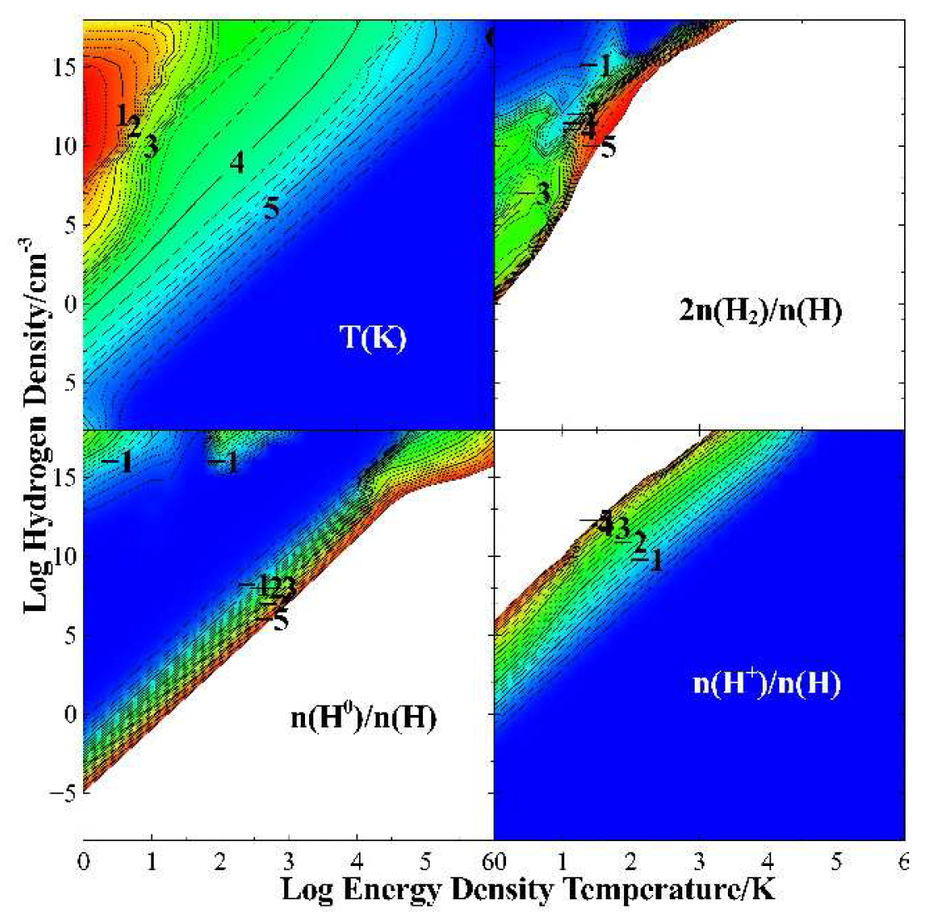

Slide 6
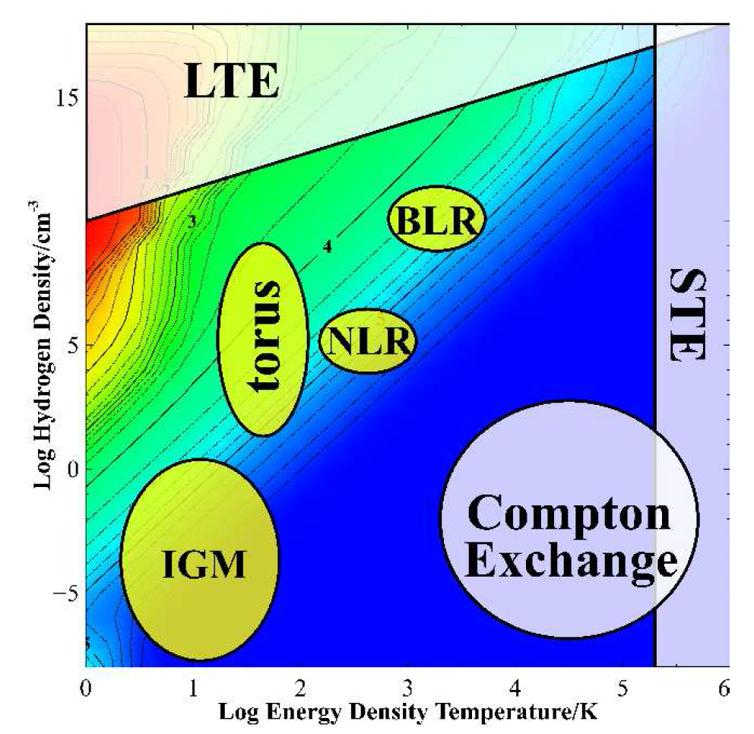

Slide 7
Open source since 1978
All versions, all data, on svn at nublado.org
You are most welcome to help!

Slide 8
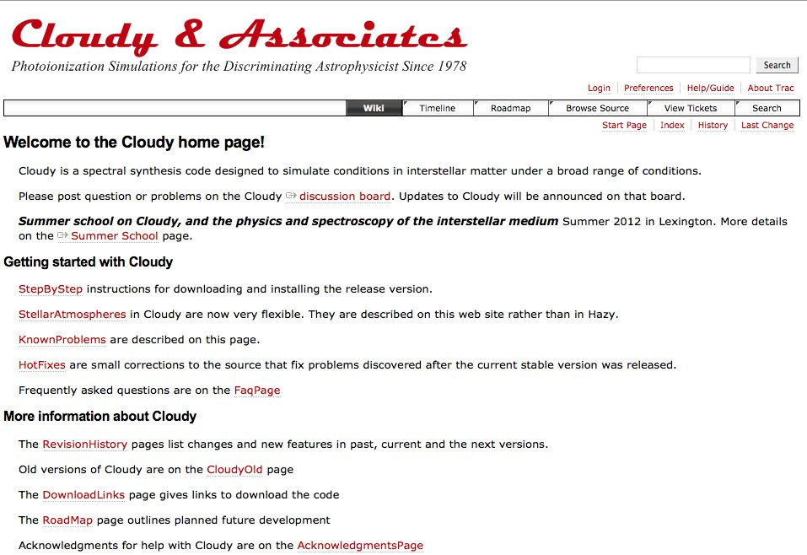
https://www.nublado.org/
Notes:
Lots of information about Cloudy

Slide 9
https://www.nublado.org/
Notes:
How to download

Slide 10
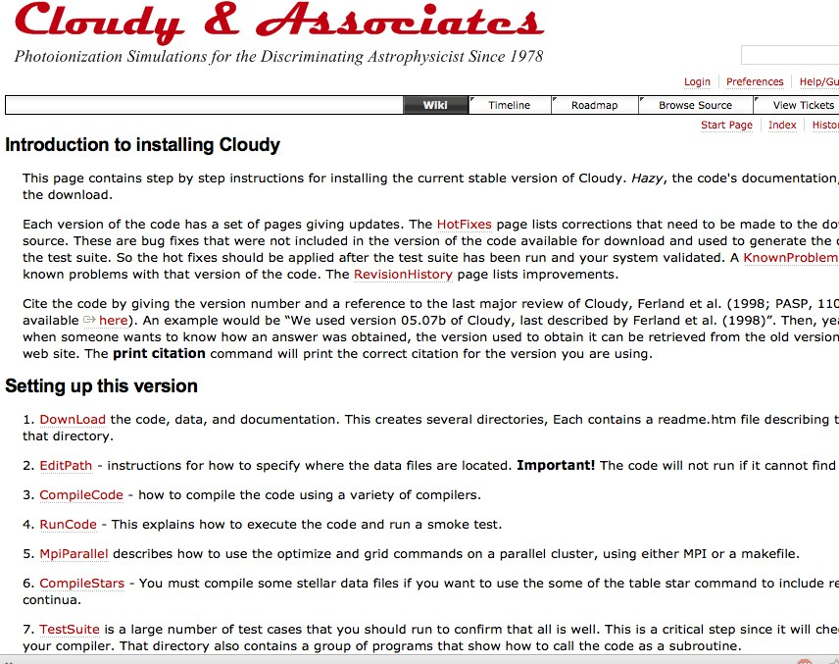

Slide 11
https://www.nublado.org/

Slide 12
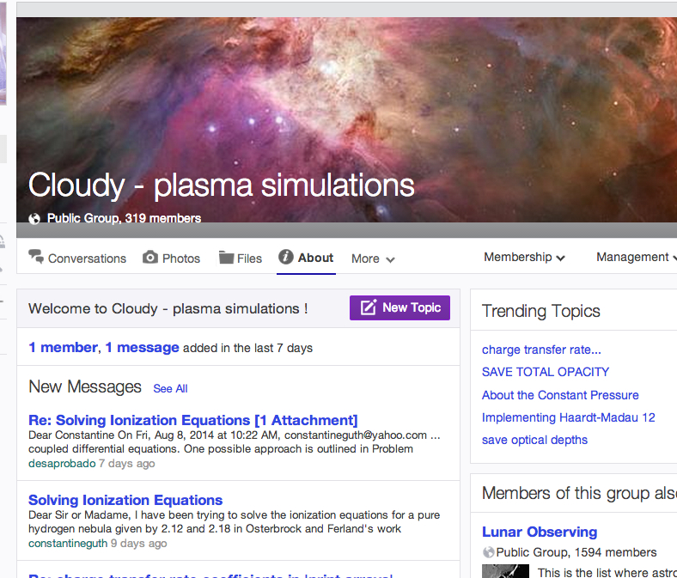
Where to go for help
https://groups.yahoo.com/neo/groups/cloudy_simulations/info

Slide 13
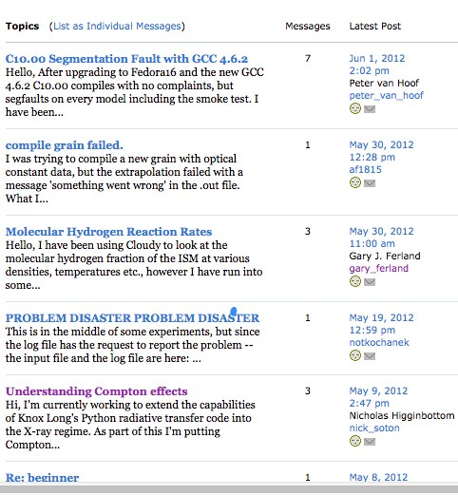

Slide 14
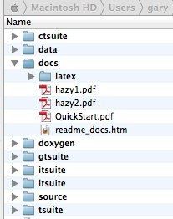
Documentation
Quick start guide
Hazy 1, all commands
Hazy 2, description of output, comparison with observations
Hazy 3, not compiled, badly out of date, some physics is described there

Slide 15


Slide 16
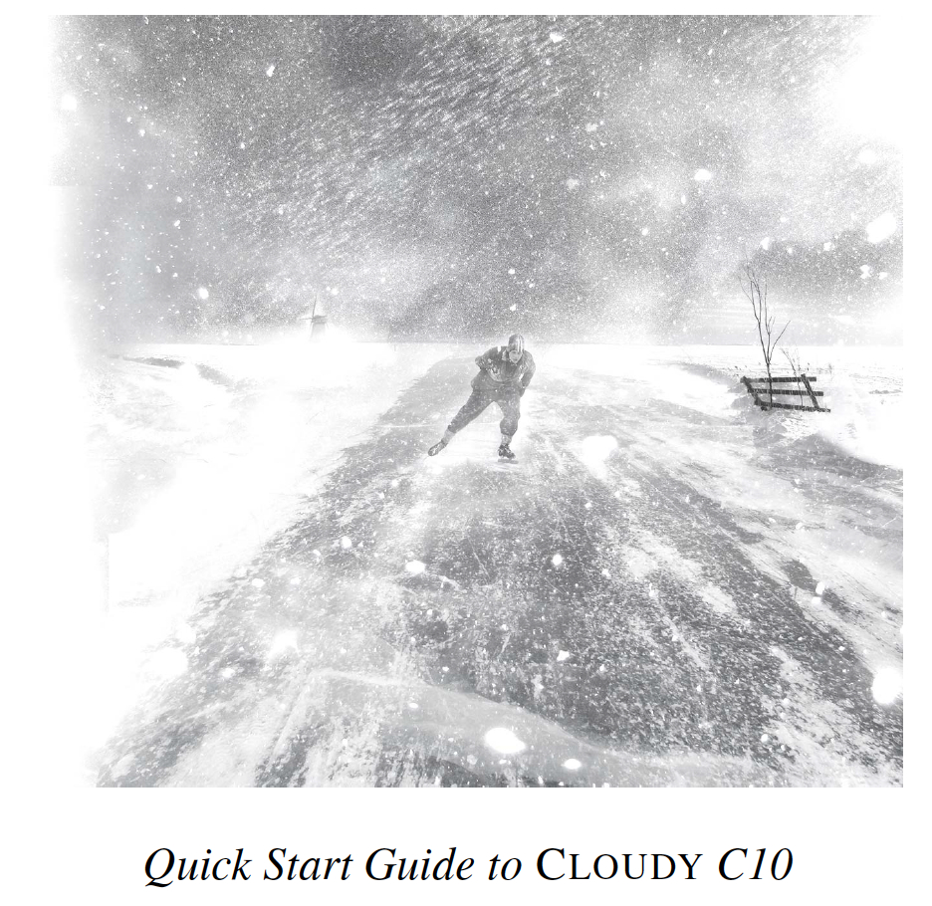

Slide 18
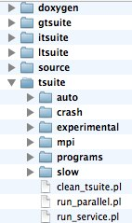
The test suite
Fully tests the code after any changes
  “Monitors” allow automatic comparison of current with previous results
Provides examples of how to use Cloudy
  But may include extraneous commands for testing
Useful examples of how to set up a simulation

Slide 19
Running cloudy
“run” file contains
path-to-cloudy.exe -r $
If file “model.in” contains input, then
run model &
Produces output “model.out”

Slide 20
Minimum to run Cloudy
Must specify
  SED – shape of the radiation field
  Flux of photons per unit area
  Gas density
May specify
  Gas composition, grains (grain-free solar by default)
  Gas equation of state (often constant density)
  Stopping criterion, often physical thickness

Slide 21
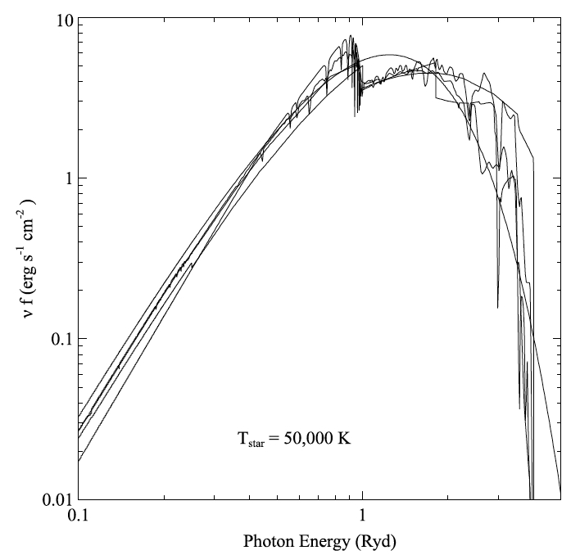
Parameters – the SED
Quick start guide Chapter 5
Hazy 1, Chapters 4, 6
Can be specified as a
fundamental shape
such as a blackbody
Generally entered as
table of points

Slide 22
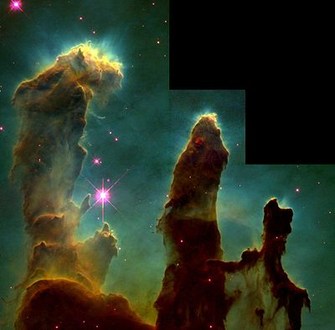
SED brightness – the intensity case
Specify ϕ(H) – photons per
unit area
  The “intensity case”
  predicts emission per unit
  area
  Inner radius of cloud does
  not need to be specified
Notes:
Show cartoon of cylinder viewed edge on, ray through it, limb brightening

Slide 23
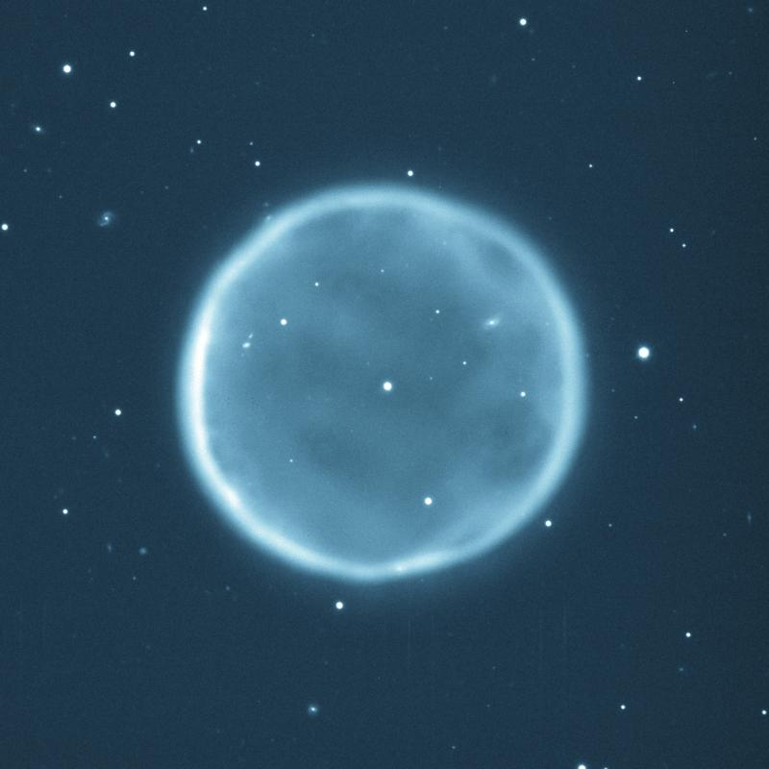
SED brightness – the luminosity case
Specify Q (H) – photon luminosity
  Inner radius of cloud must
  be specified, since
  φ(H) = Q(H) / 4π r²
  predicts emission line
  luminosities

Slide 24
The “main output”
The *.out file created when code is executed
  QSG 7.1 & Hazy 2 Chapter 1
Gas & grain composition
Physical conditions in first and last zone
Emission line spectrum
Mean quantities
Cloudy is designed to be autonomous and self aware
Will generate notes, cautions, or warnings, is conditions are not appropriate.

Slide 25
“Save” output
Requested with various “save” commands
  Hazy 1 Section16.35 and later
The main way the code reports its results

Slide 26
The Orion H II Region
Based on Baldwin, Ferland, Martin+91 model
Layer in hydrostatic equilibrium
Only the H II region (so faster)
Cloudy / tsuite / auto / orion_hii_open.in

Slide 27
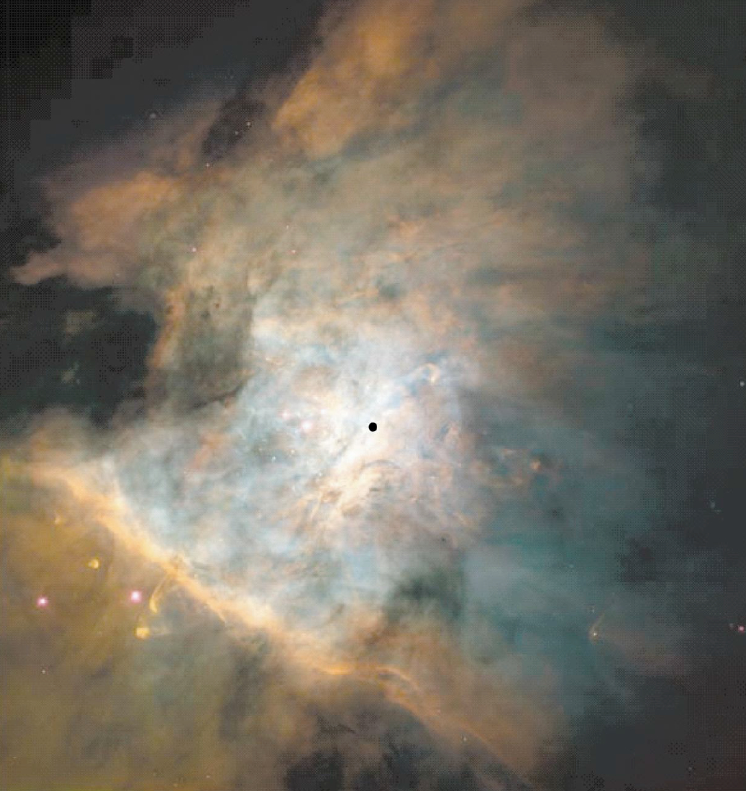

Slide 28
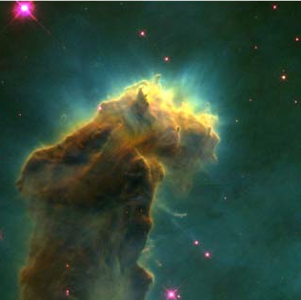

Slide 30
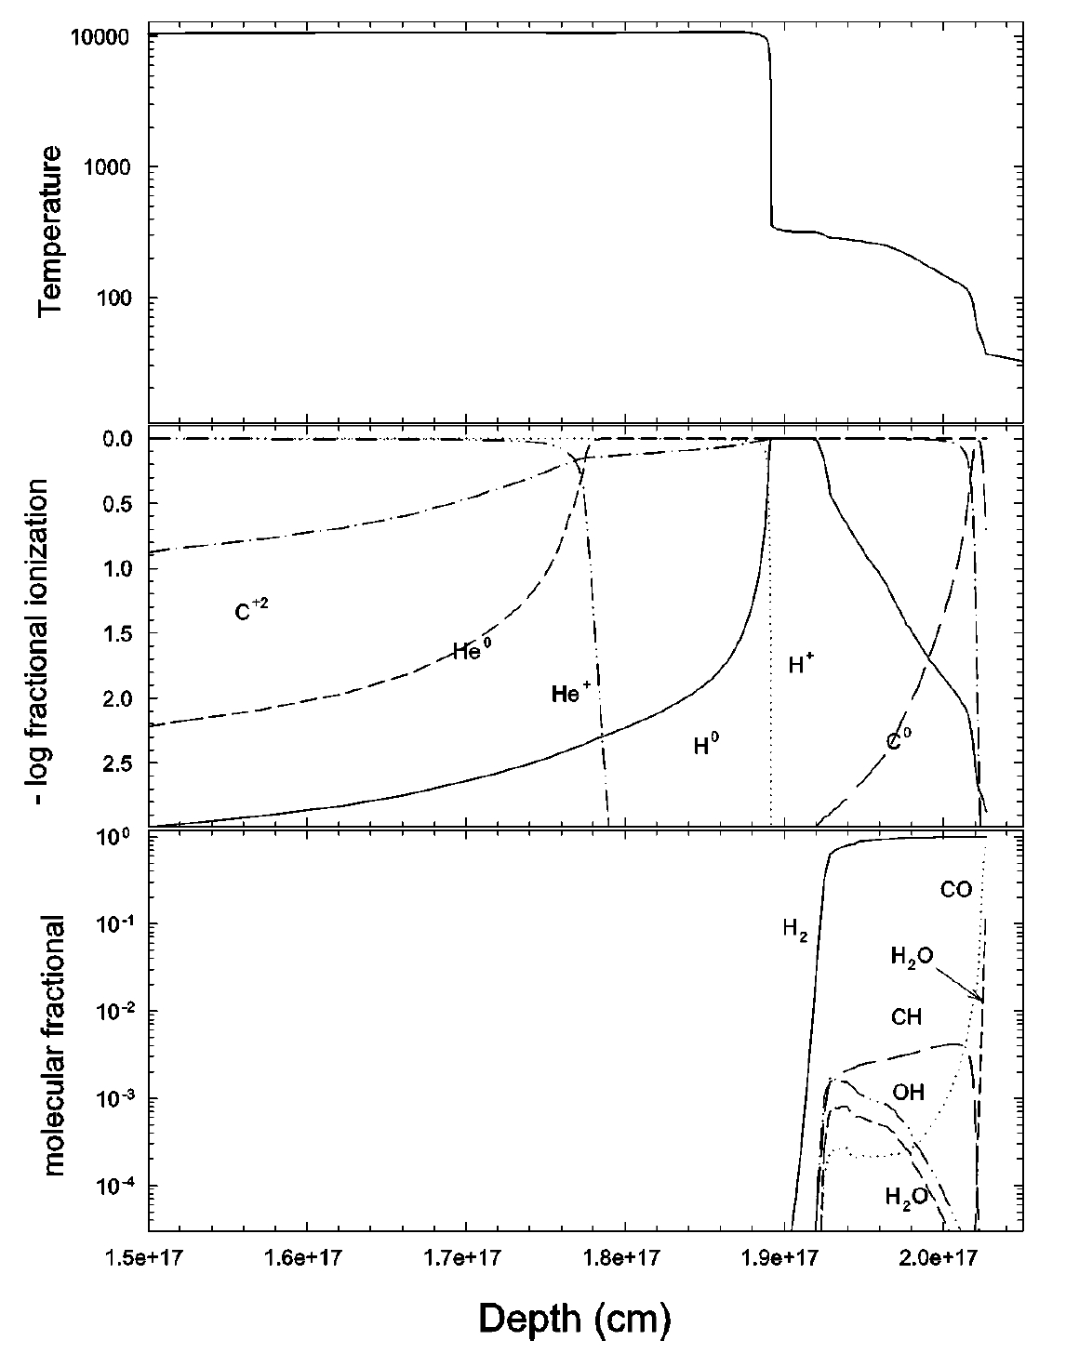

Slide 31
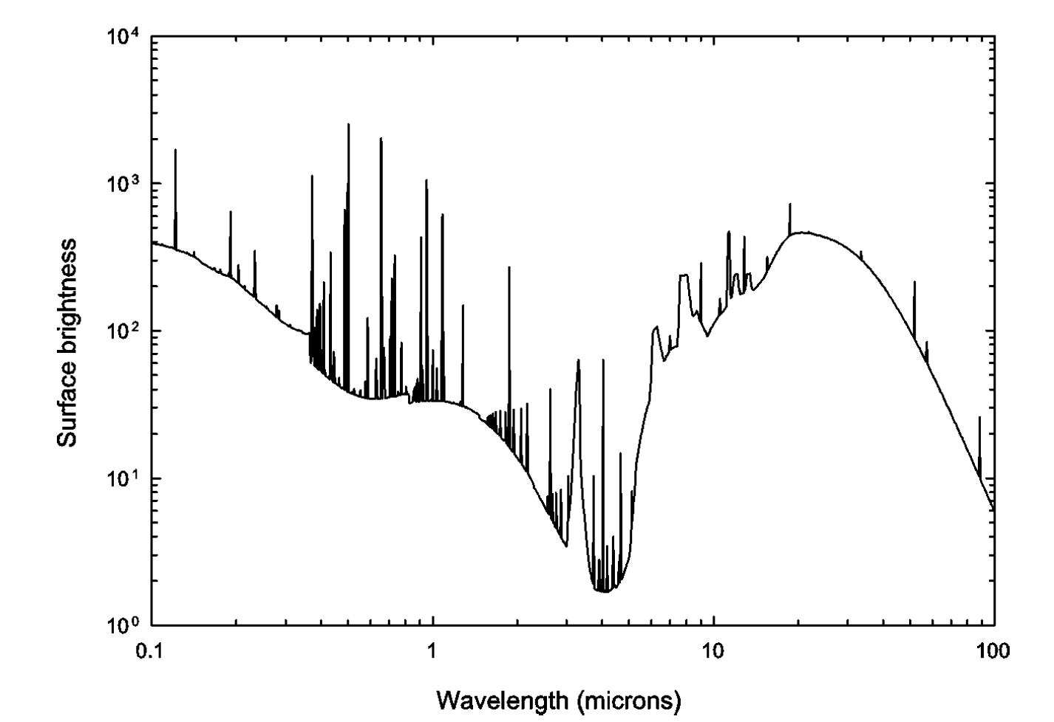
Notes:
Predicted spectrum
Lots of emission lines
PAH emission
Thermal dust emission
From study of spectra
Find abundances, -> dust survives in ionized gas because Al, Ca, Fe, Si abundances are depleted (PAHs are destroyed)

Slide 32
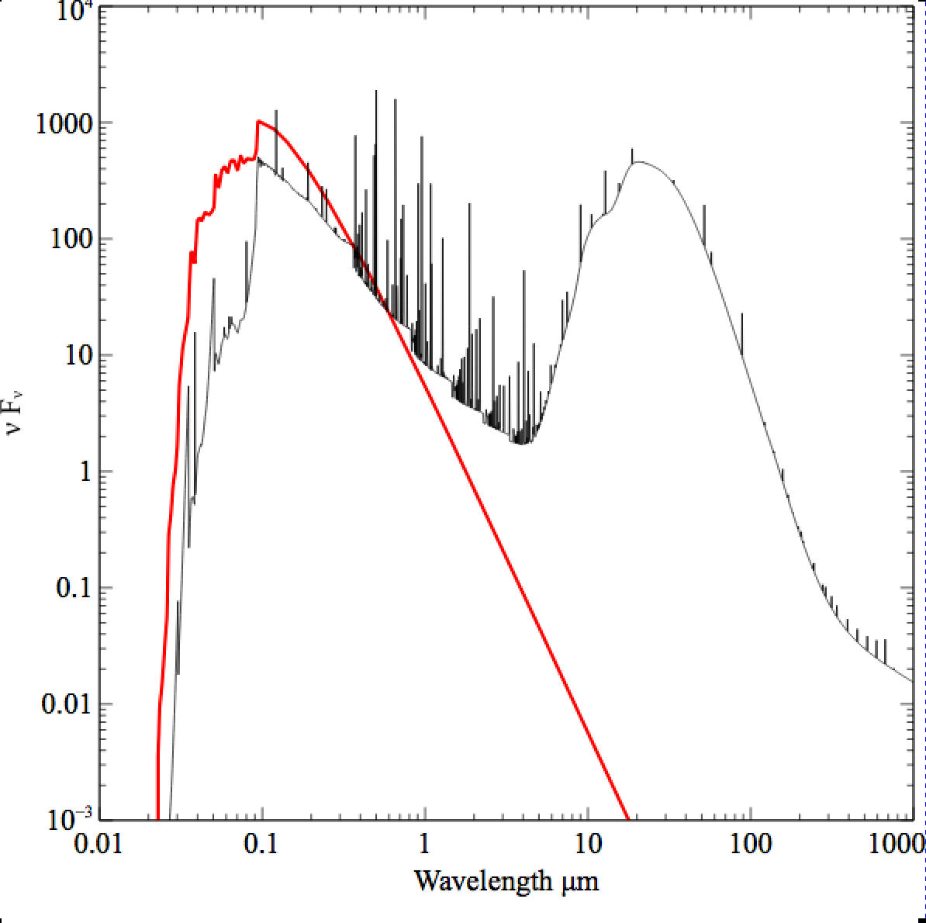

Slide 33
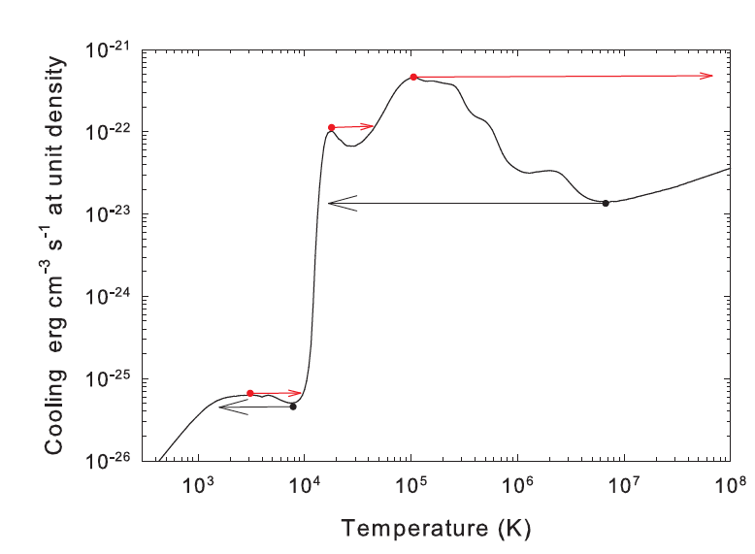
Notes:
Something sets a heating rate
Three temperatures possible but only two are stable

Slide 34
Minimum to run Cloudy
Must specify
  SED – shape of the radiation field
  Flux of photons per unit area
  Gas density
May specify
  Gas composition, grains (solar by default)
  Gas equation of state
  Stopping criterion

Slide 35
Parameters – the SED
Quick start guide Chapter 5
Hazy 1, Chapters 4, 6
Can be specified as a fundamental shape such as a blackbody
Generally entered as table of points

Slide 36
SED brightness – the intensity case
Specify ϕ(H) – photons per
unit area
  The “intensity case”
  predicts emission per unit
  area
  Inner radius of cloud does
  not need to be specified
Notes:
Show cartoon of cylinder viewed edge on, ray through it, limb brightening

Slide 37
SED brightness – the luminosity case
Specify Q (H) – photon luminosity
  Inner radius of cloud must
  be specified, since
  ϕ(H) = Q(H) / 4π r²
  predicts emission line
  luminosities

Slide 38
Cloud density
“hden” command
Constant density by default
Other equations of state possible

Slide 39
Composition
Solar, no grains, by default
Other standard mixes possible

Slide 40
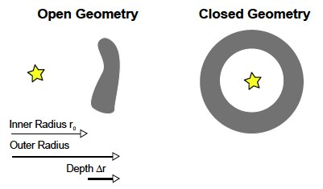
Open vs closed geometry Hazy 2.3

Slide 41
Covering and filling factors
Covering factor
  AGN3 …
Filling factor, how to do clumps
  AGN3, hazy1

Slide 42
Strömgren length

Slide 43
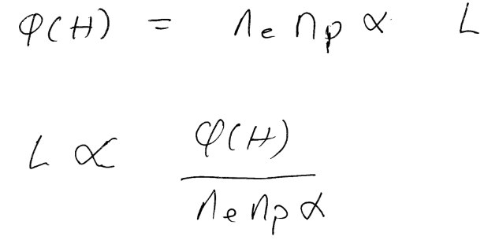
Strömgren length
Number of ionizing photons entering layer
is balance by
number of recombinations along it

Slide 44
Matter vs radiation bounded
SL is for radiation bounded, there is an I front
Show Abell sphere – matter bounded,
So phi(H) > SL equation
Show pics, give section in AGN3

Slide 45
Beyond the H⁺ layer
Little H⁺ ionizing radiation gets
past the H⁺ layer
Deeper regions are atomic or
molecular
Also cold and produce little visible
light
Large extinction due to dust

Slide 46
Clumping
Filling factors, when clumps smaller than photon scale length
  Osterbrock & Flather 1957
Add together distinct clouds, when clumps larger than photon scale length
  Balwin+ 1995 ApJ 455, L119+

Slide 47
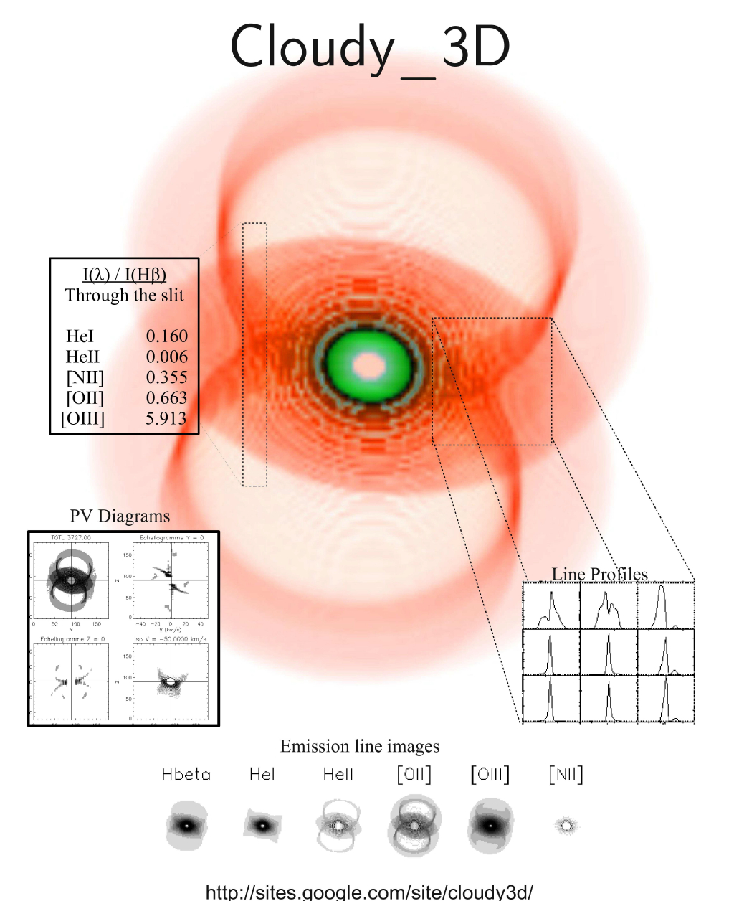
Volume elements in larger structures

