Slide 1
M16 command deck so far
blackbody, T=4.87e4 K
Q(H) 49.70
radius 19
hden 3
abundances HII region
cosmic ray background
CMB
iterate
print last iteration
save overview "M16.ovr" last
save continuum "M16.con" units microns last
save line emissivity "M16.ems" last
H 1 4861.33A
O 1 6300.30A
Blnd 3727.00A
O 3 5006.84A
end of lines
*******************************
Notes:
Comments removed

Slide 2
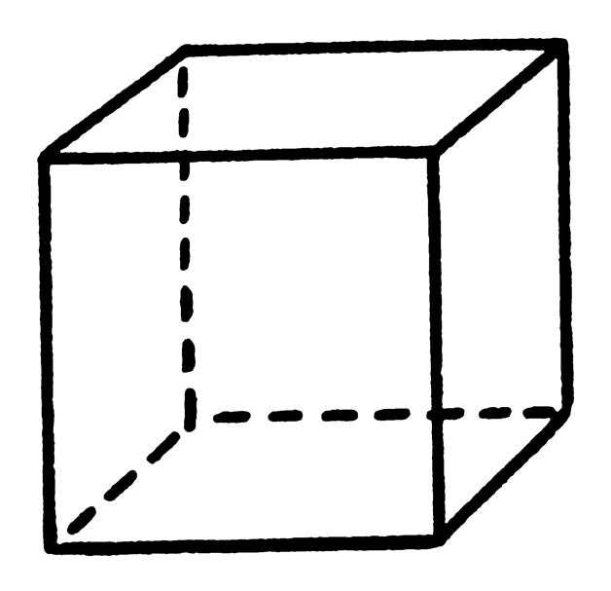
A “unit cell”
We will sometimes model a cubic cm of matter
  A “unit cell”, 1 cm³
Lots faster & simpler
These commands do a single “zone” that is log(dr)=0 (or 1 cm) thick
  stop zone 1
  set dr 0

Slide 3
Command deck as unit cell
Stop zone 1
Set dr 0
blackbody, T=4.87e4 K # the AGN3 Table 2.3 entry for O4 V
Q(H) 49.70
radius 19
hden 3
abundances HII region
cosmic ray background
CMB
iterate
print last iteration
save overview "M16.ovr" last
save continuum "M16.con" units microns last
Notes:
Add two commands to do unit cell, much faster

Slide 4
Only save spectrum emitted by the cloud
stop zone 1
set dr 0
blackbody, T=4.87e4 K # the AGN3 Table 2.3 entry for O4 V
Q(H) 49.70
radius 19
hden 3
abundances HII region
cosmic ray background
CMB
iterate
print last iteration
save overview "M16.ovr" last
save emitted continuum "M16.con" units microns last

Slide 5
Results for one zone
Gas kinetic temperature

Slide 6
Results for one zone
H⁰, H⁺ ionization fractions
n(x)/n(H, all forms)

Slide 7
Results for one zone
H₂ fraction
2n(H₂)/n(H, all forms)

Slide 8
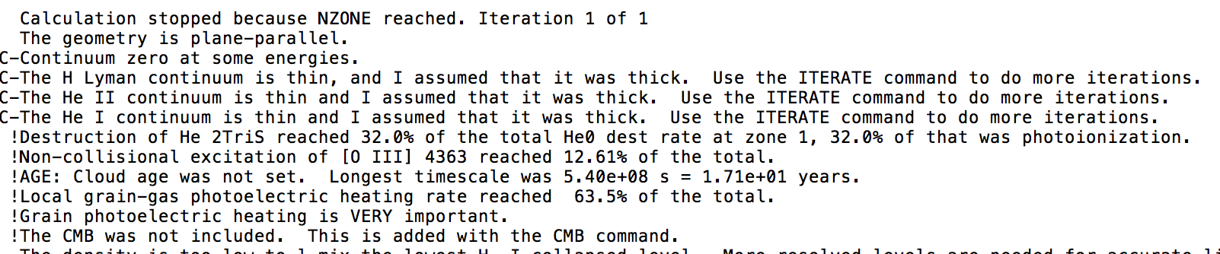
Warnings, cautions, notes
Cloudy is designed to be autonomous and self aware
Generates notes, cautions, or warnings, if conditions are not appropriate.

Slide 9
Check end of output

Slide 10
Break into 6 groups, do 6 radii
Radius. (log, cm)
  13
  15
  17
  19
  21
  23

Slide 11
Save prefix file names
  Save overview “HII.ovr” last no hash
  Save element hydrogen “HII.hyd” last no hash
  Save emitted continuum “HII.econ” units microns
  Set save prefix “HII”
  Save overview “.ovr” last no hash
  Save element hydrogen “.hyd” last no hash
  Save emitted continuum “.econ” units microns

Slide 12
We did 10¹⁹ cm, about 3 pc
Now do 21, 23
17, 15, 13

Slide 13
The grid command – Hazy1 Chap 18
Grid command computes a grid of models in parallel
Include “vary” keyword on commands with variable parameters (Chapter 17.4)
“grid” command specifies lower, upper bounds, and step size
  Radius 13 vary
  grid 13 23 2
  Hazy 1 sec 18.5
    Special rules for temperature grids
Models are done in parallel on multi-core machines

Slide 14
The grid command – Hazy1 Chap 18
“Save grid” command saves step parameters
  Check for problems
“no hash”, “last”, options on other save commands
(See this page for description of –a runtime)

